Slide 1


INSIGHTS WITH IMPACT:
Revealing Key Learnings from the Automation of Behavioral Science
Speakers
Aaron Reid, Ph.D
Sentient Decision Science
Jason Chebib
VP Insights, Diageo

Slide 2
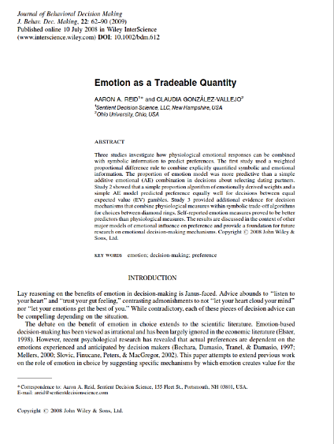

A key principle for automating behavioral science: ground your research in sound psychological theory.
The Proportion of Emotion Model combines emotion and reason into a single predictive choice algorithm for more accurate understanding and forecasting of behavior.
(Reid & Gonzalez-Vallejo, 2008)

Slide 3
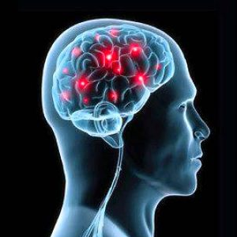
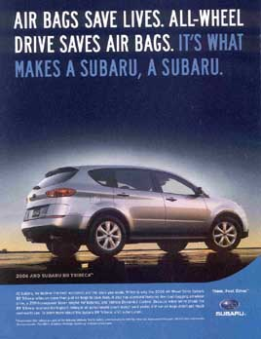
Even if we consciously dismiss a claim, automatic associations still influence our decisions.
“ADVERTISING DOESN’T WORK ON ME”
SAFETY
Even if consciously ignored, neural associations are automatically activated, elevating certain criteria in our decisions.

Slide 4
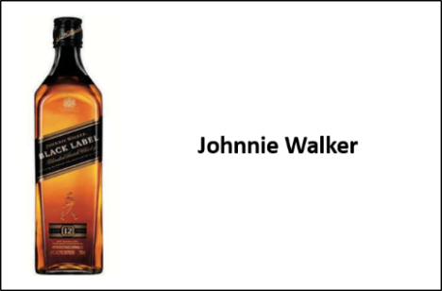
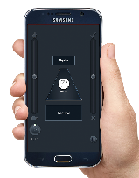
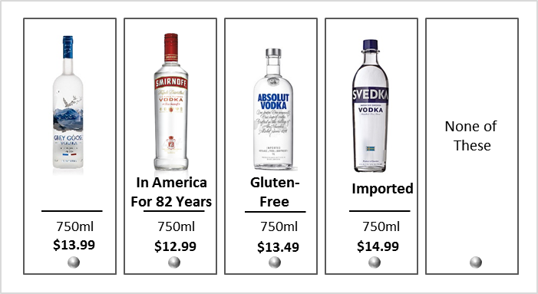
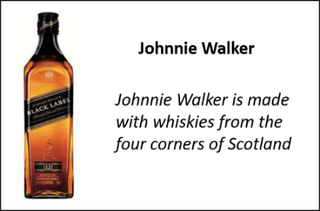
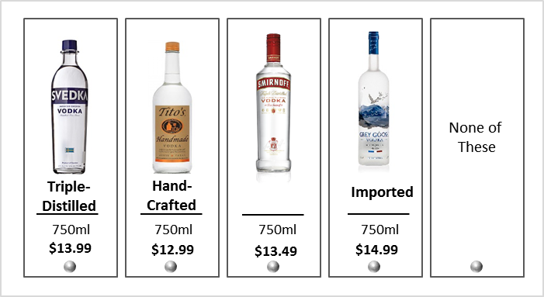
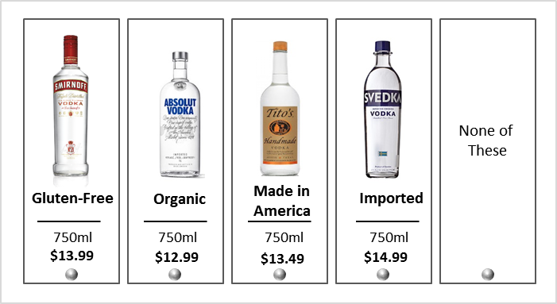

Implicitly measuring the behavioral impact of claims is more predictive of “apparent” marketplace irrationalities.
CONTROL EXPOSURE
EMOTION + REASON
MESSAGE EXPOSURE
EMOTION + REASON
DIFFERENCE = IMPACT
DIFFERENCE = IMPACT
4

Slide 5


Johnnie Walker

Slide 6

Automation enables rapid scientific knowledge creation, providing fundamental behavioral insights with business impact.
IT PAYS TO BE THE BEST AT SOMETHING
Superlatives (the best, #1, etc.) usually out-perform other claims, particularly vs. large competitive brands – but are less insulating over the long-term
BRAND MESSAGES HALO, PRODUCT CLAIMS CANNIBALIZE
If there are multiple products in a brand portfolio, broad promotional messages halo to the portfolio, whereas product-specific message are more likely to cannibalize
FOCUS ON THE PRODUCT, NOT THE COMPANY
Claims work better when the product is the topic, vs. how long the company has been in business, or how committed it is
COMPETITIVE CLAIMS WORK AGAINST COMPETITORS
Making a superiority claim against a larger competitor usually works well, but will likely halo slightly to that competitor while sourcing more significant volume from others

Slide 7

It pays to be the best at something.
JOHNNIE WALKER
Example : Claims related to being the best drive preference for the brand while other categories of claims do not.

Slide 8

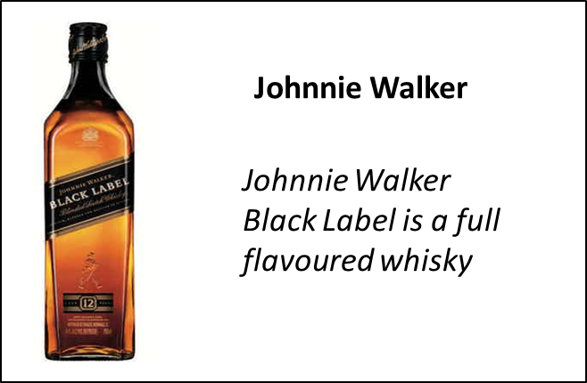
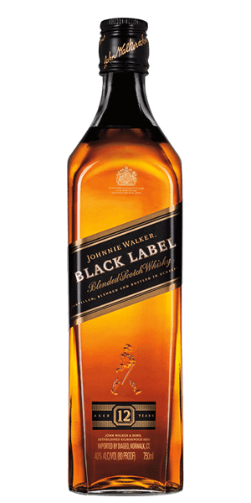
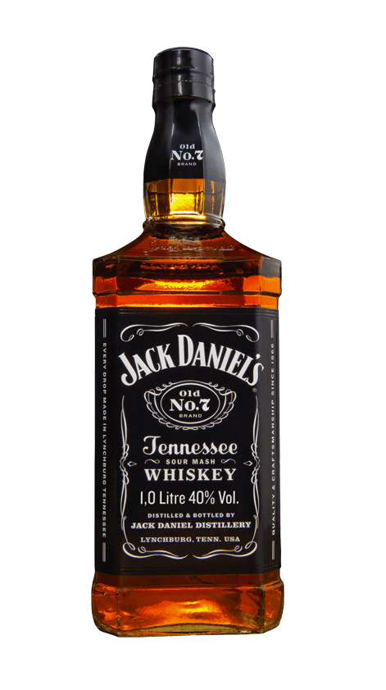
Brand messages halo, product claims cannibalize.
JOHNNIE WALKER
Example : In the U.S., messages that refer to scotch as “whisky” halo to the leading whisky brand.

Slide 9
Focus on the product, not the company.
JOHNNIE WALKER
PRODUCT AS SUBJECT:
IMPACT OF MESSAGES FOCUSED ON “WHERE OR HOW THE PRODUCT IS MADE”
COMPANY AS SUBJECT:
IMPACT OF THE SAME MESSAGES FOCUSED ON “HOW OR WHERE THE COMPANY MAKES THE PRODUCT”
Pt. Change in Vol. Share
PARALLEL MESSAGES, CONTRASTING RESULTS

Slide 10
Competitive claims work against competitors.
JOHNNIE WALKER
Example : The vast majority of share sourced by a claim is from non-targeted brands in the consumer repertoire.
Share sourced from the brand targeted by the competitive comparison

Slide 11
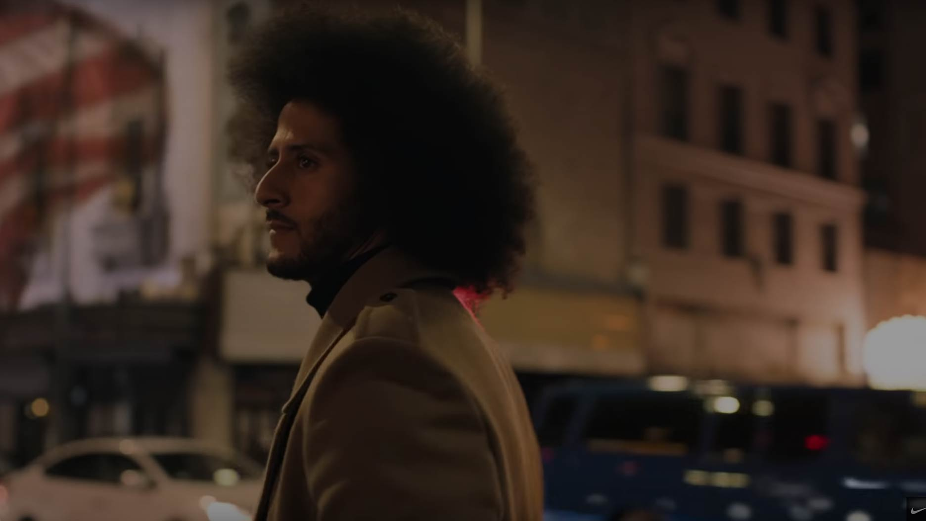

“Dream Crazy”

Slide 12

The Attention, Affect, Memory & Desirability model of persuasive communication forms a sound foundation for automated ad testing.
Content won’t be successful unless it makes it past our eyes & ears to begin with
We all want our creative to be entertaining, but its persuasion that pays the bills.
ENGAGEMENT
ENGAGEMENT
ATTENTION
It has to be seen
Maintaining focus
MEMORY
It has to be remembered
Internalizing
AFFECT
It has to be seen
Involvement
DESIRABILITY
It has to have lift preference
Relevance & differentiation

Slide 13
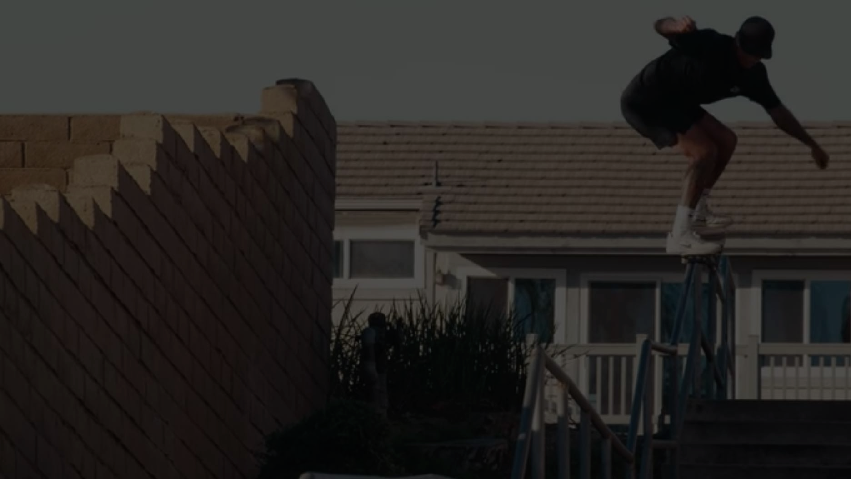
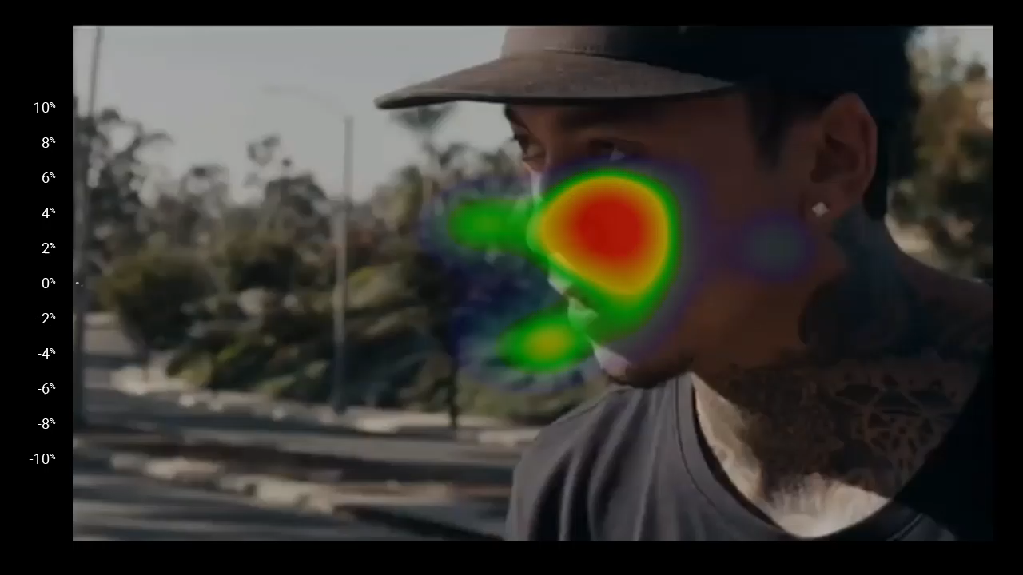
Dream Crazy – 90 Second Ad
SNAPSHOT
Marketing success depends on both emotional engagement and emotional influence.
  Moment by moment attention and emotion can be captured via scaled eye-tracking and facial coding technologies – revealing the emotional engagement strengths and weaknesses of your creative.
  Implicit emotional lift in desire for your brand builds off engagement that is memorable –as captured through implicit memory measures and combined emotion and reason models.
Percentage of Positive (+) or Negative (—) Responses
Percentage of Positive (+) or Negative (—) Responses
VALENCE
POSTIVE
EMOTION
NEGATIVE
EMOTION
ENGAGEMENT
ATTENTION
AFFECT
INFLUENCE
MEMORY
DESIREABILITY
96th
34th
51st
38th
Notes:
The production of Dream Crazy captivates attention, yet underdelivers on emotional engagement.
The lack of emotion influences degree of memory for the brand.
While providing an overall positive lift for the brand, Dream Crazy underperforms the marketplace norms.

Slide 14

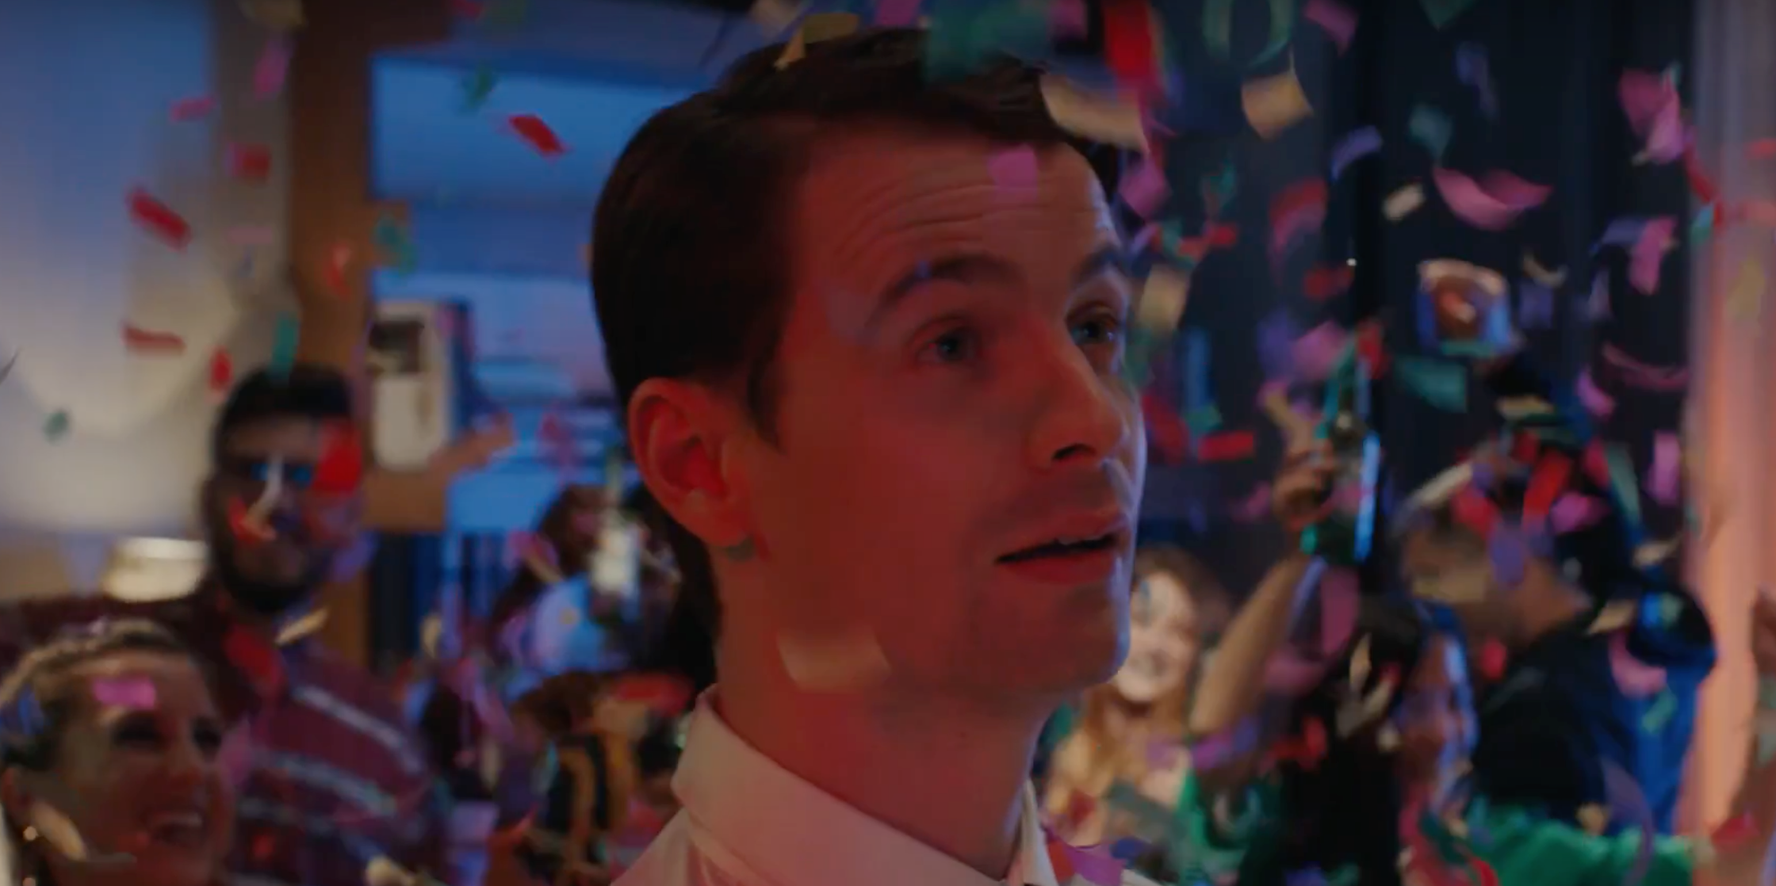
Show, Don’t Tell
PRINCIPLES OF AFFECT
In the Corona spot, we see a common advertising mistake known as “mirror” advertising, in which the audience is shown pictures of themselves as reminders of what are deemed to be meaningful situations instead of telling a story like Heineken that takes the audience on a journey to elicit a fresh visceral response.
% VALID FIXATIONS
21st
PERCENTILE
AVG TIME
FIXATING
% VALID FIXATIONS
68th
PERCENTILE

Slide 15
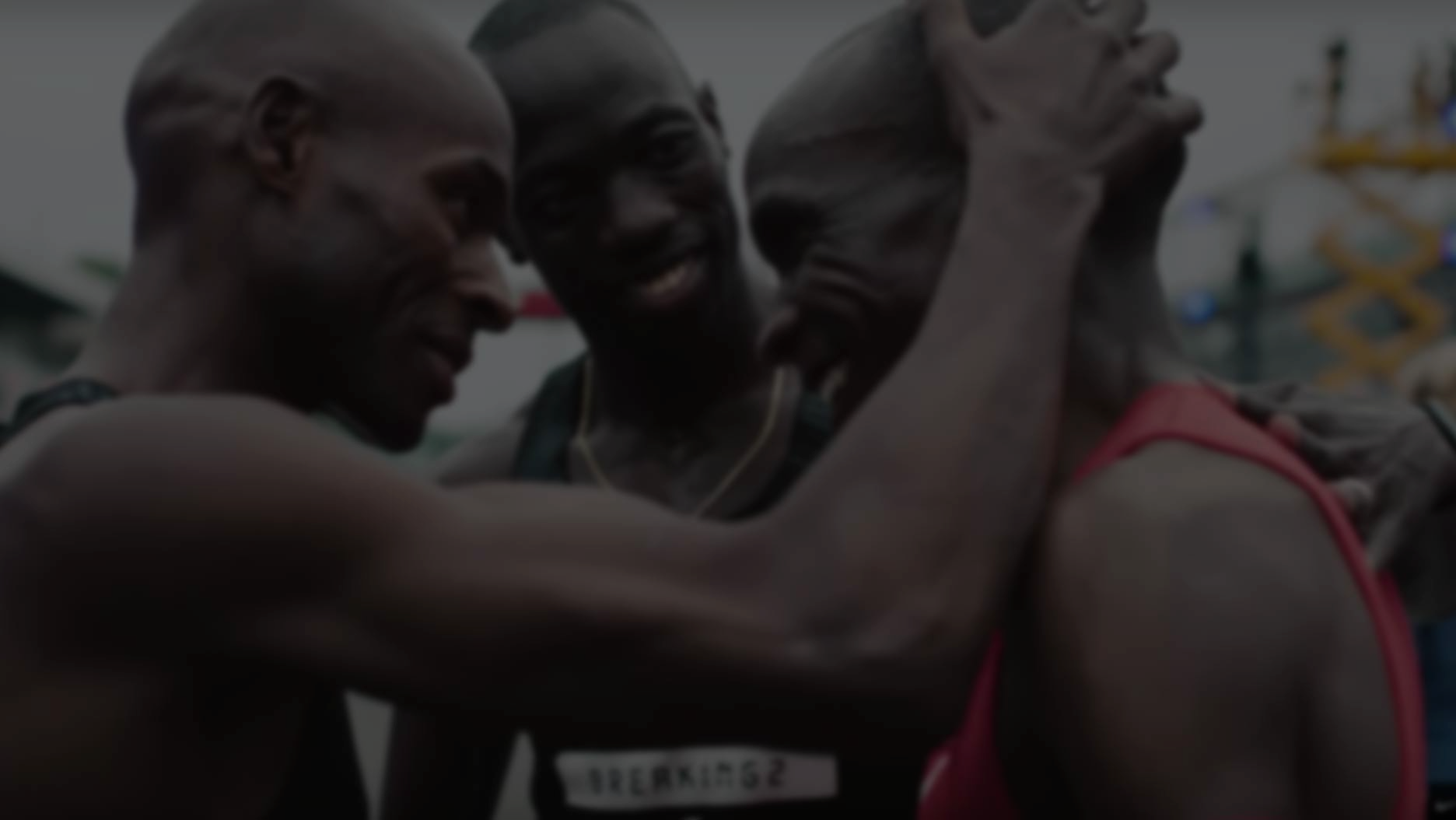
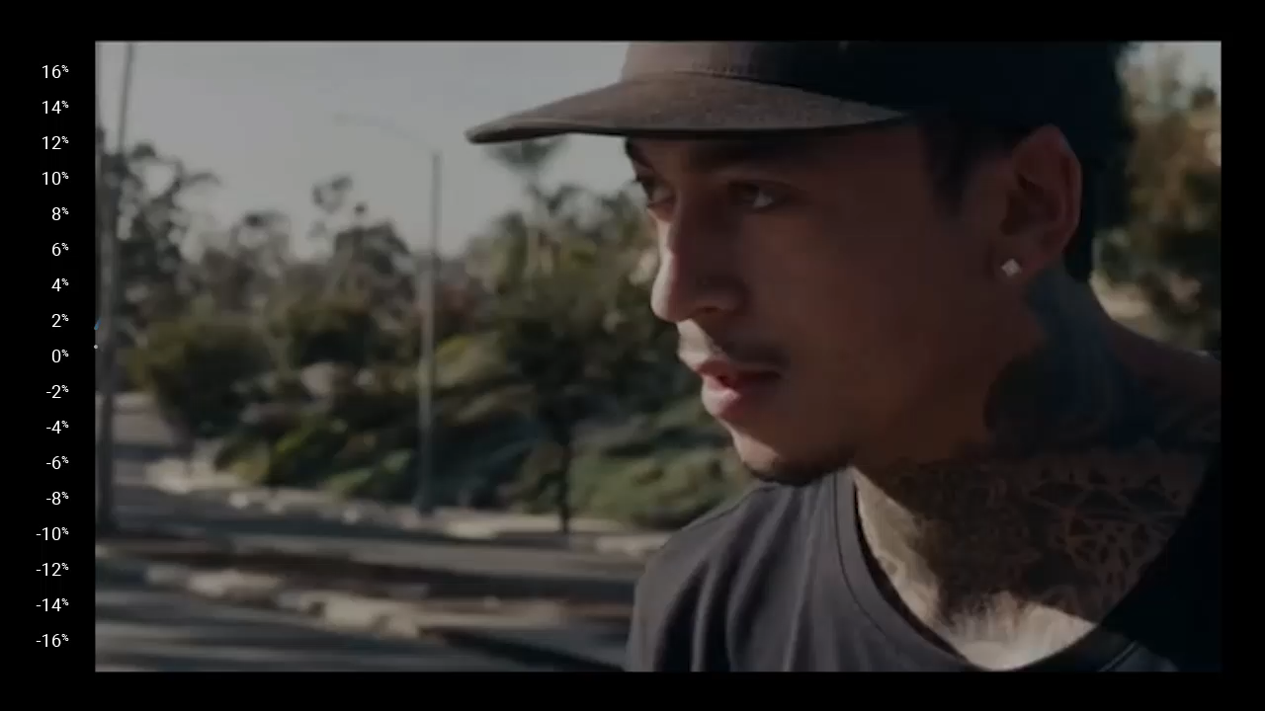
Dream Crazy – 90 Second Ad
EMOTIONAL MEMORY ANALYSISTM
It is not the presence of negative emotion, but rather it is the absence of any emotion, that is the enemy of effective advertising.
Percentage of Positive (+) or Negative (—) Responses
VALENCE
IMPLICIT
POSITIVE
INFLUENCE
SEGMENT

Slide 16
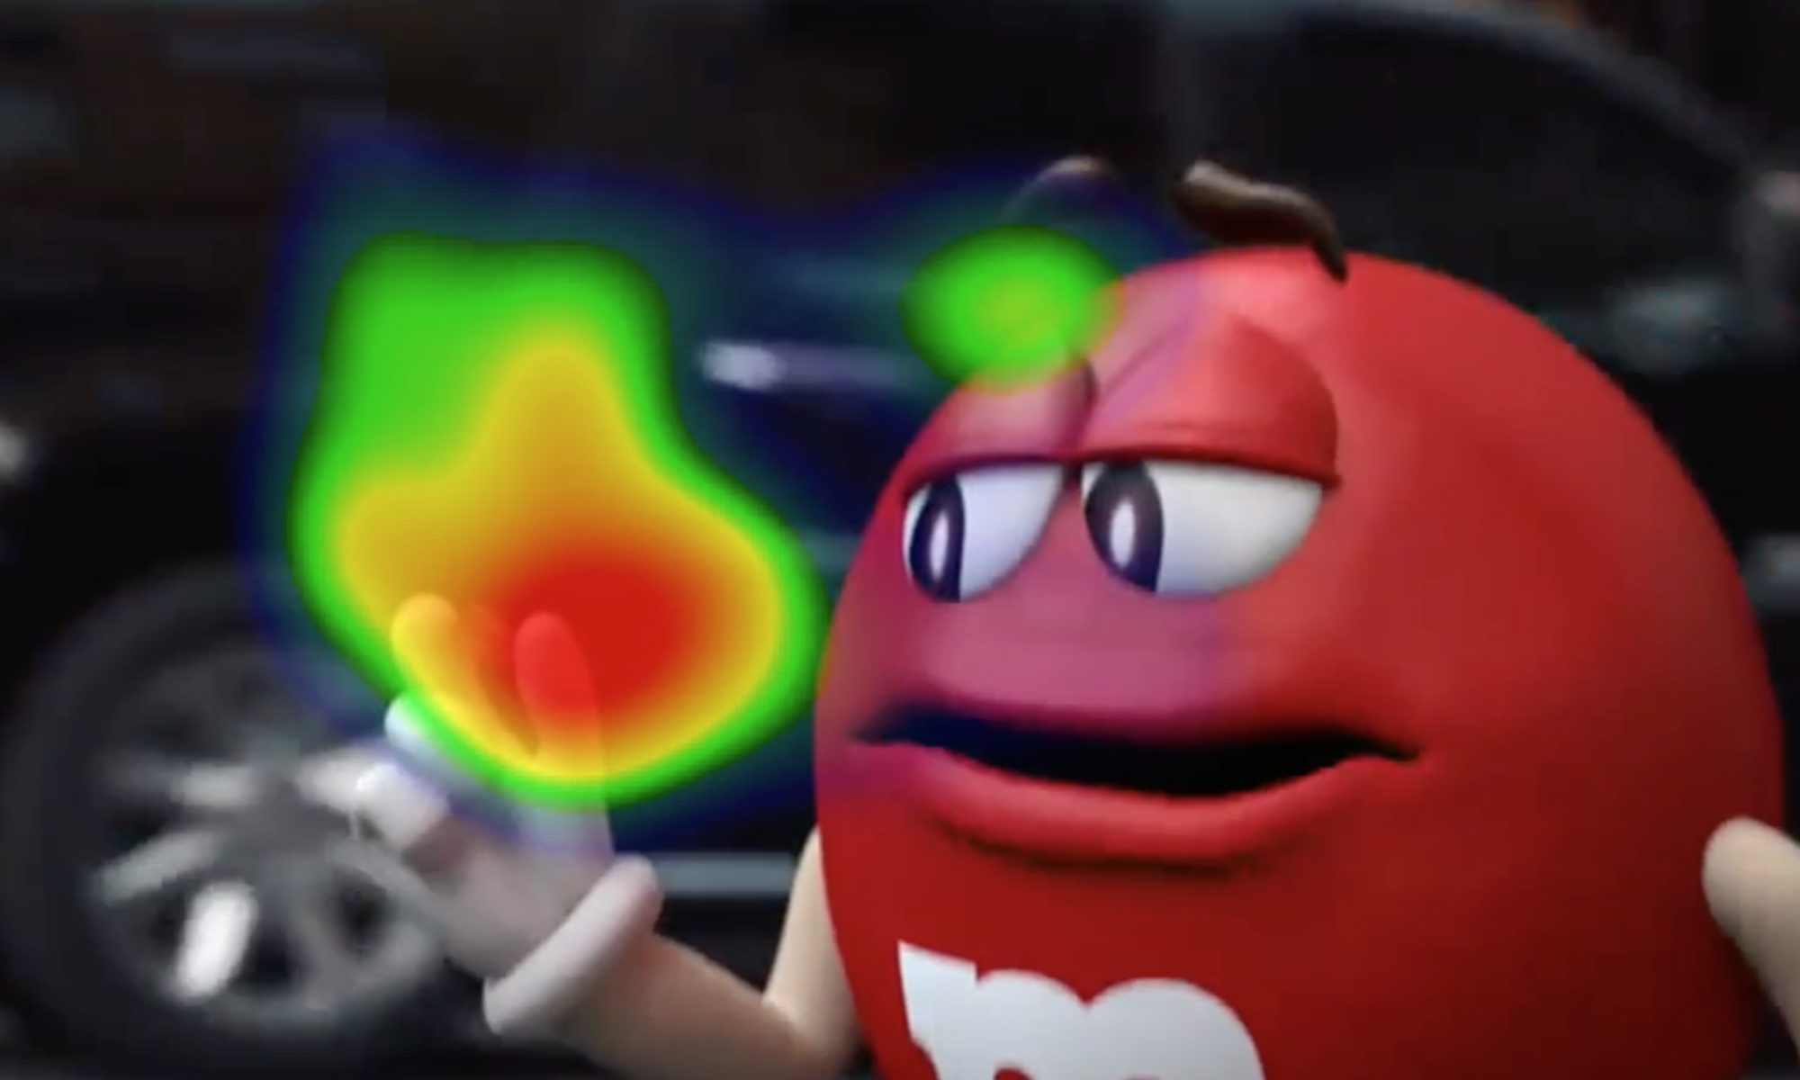
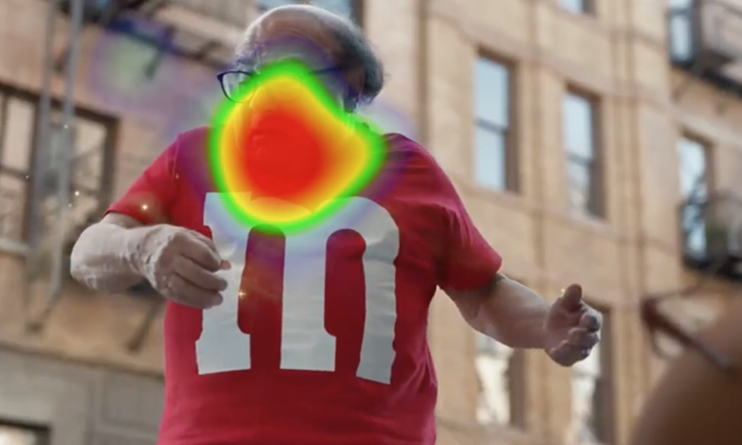
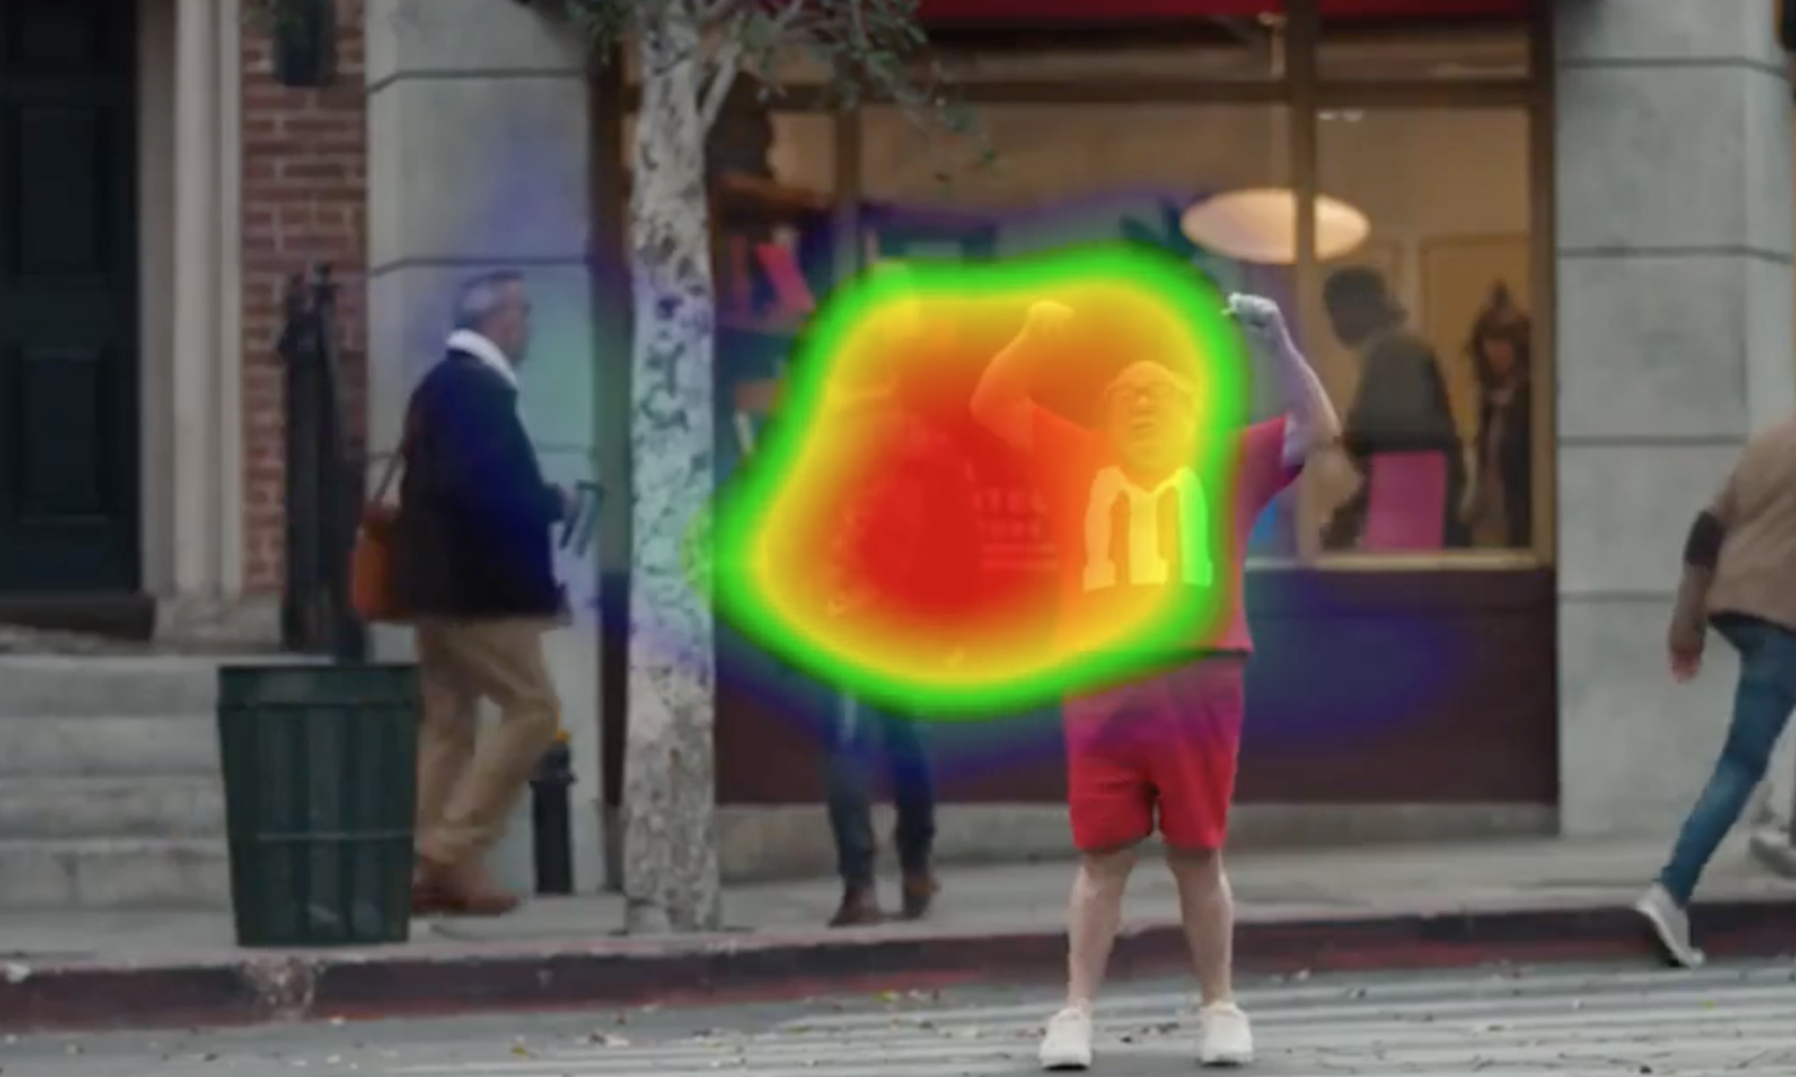
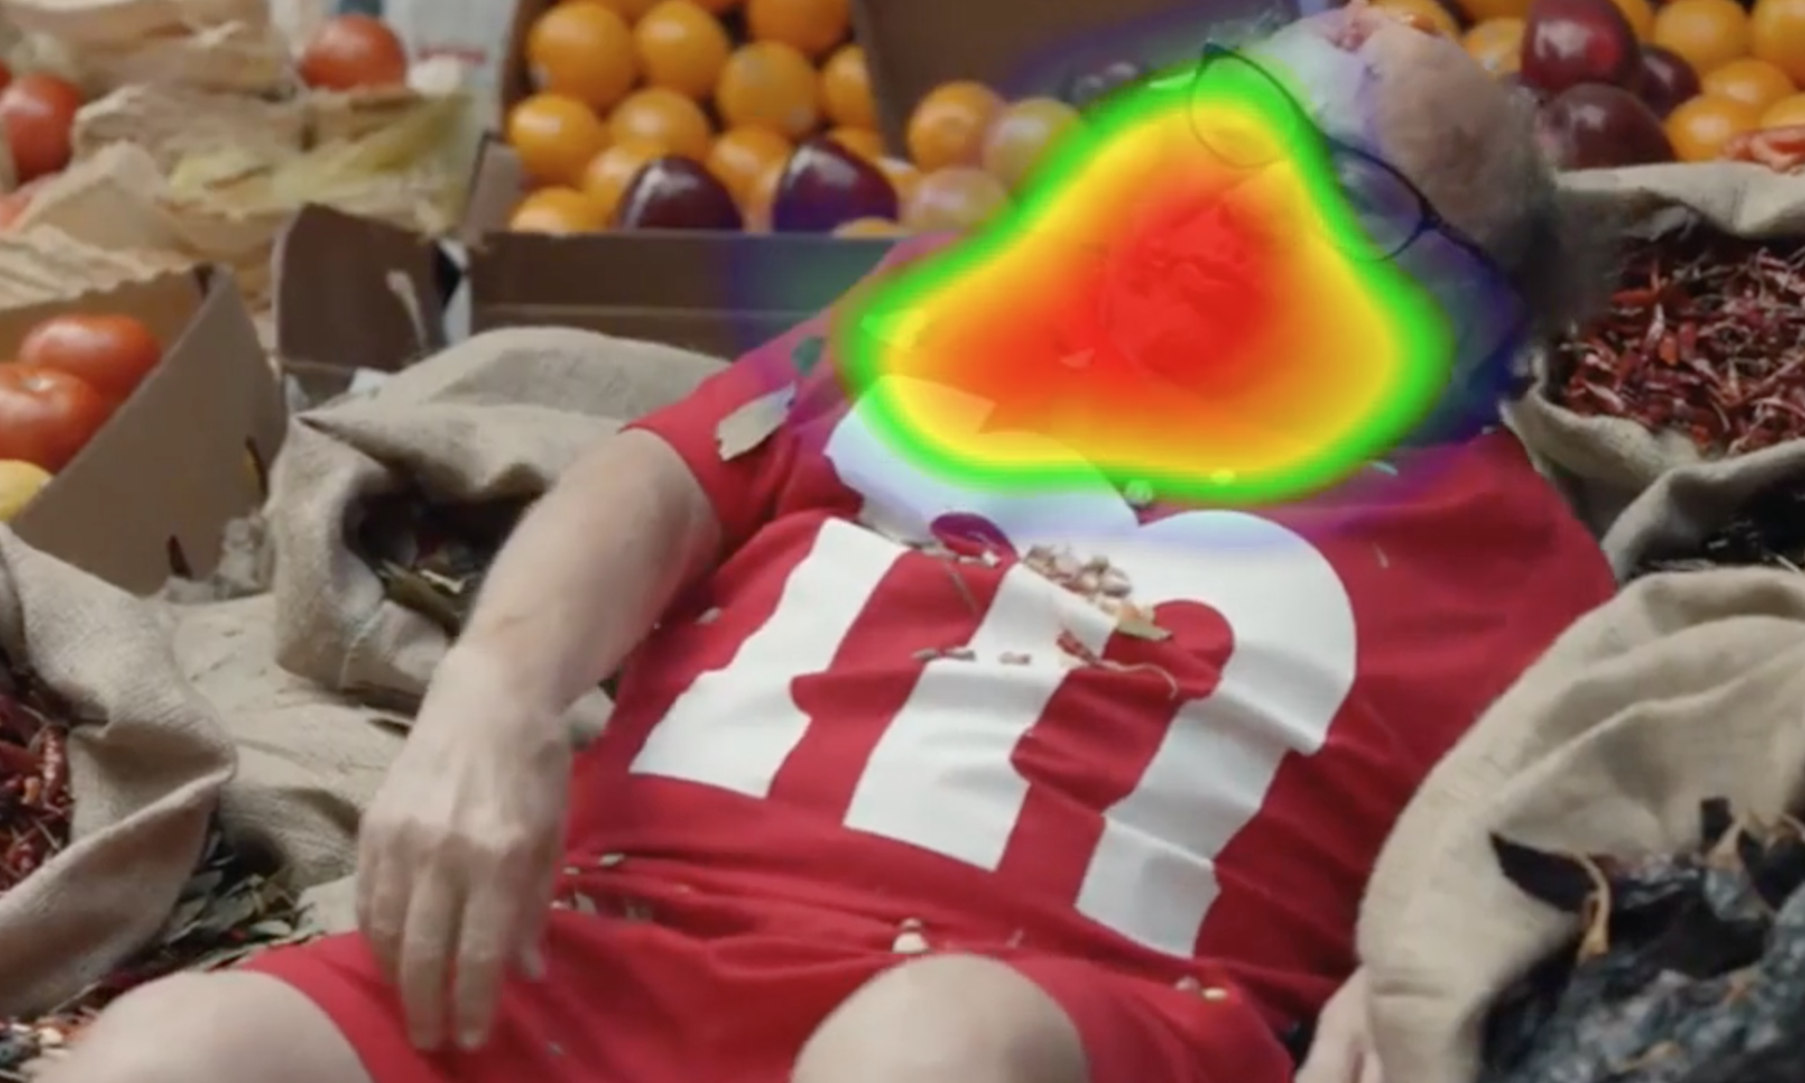
Give the Product a Starring Role
PRINCIPLES OF MEMORY
If the product is not a necessary “actor” in the spot, then the ad can easily be recalled without it. In this example, the product is the primary source of tension (emotion) in the spot.
91st
PERCENTILE
M&M’s®, Human (Featuring Danny Devito)
Super Bowl Commercial 2018

Slide 17
The Degree that Time of Brand on Screen Impacts Memory
PRINCIPLES OF MEMORY
For every one second the brand appears on screen, Memory percentile rank increases by 1.5 pts
A change from 5 seconds on screen to 15 seconds, moves your ad from the lower third to above average in Memory for your brand.

Slide 18
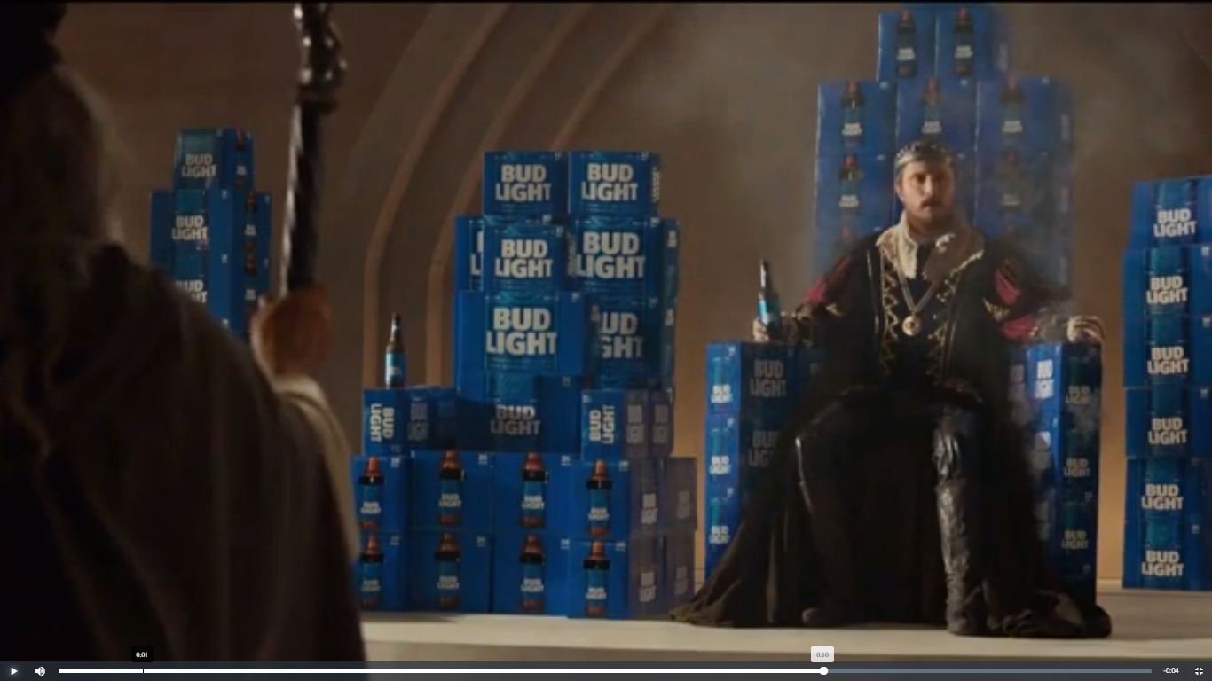
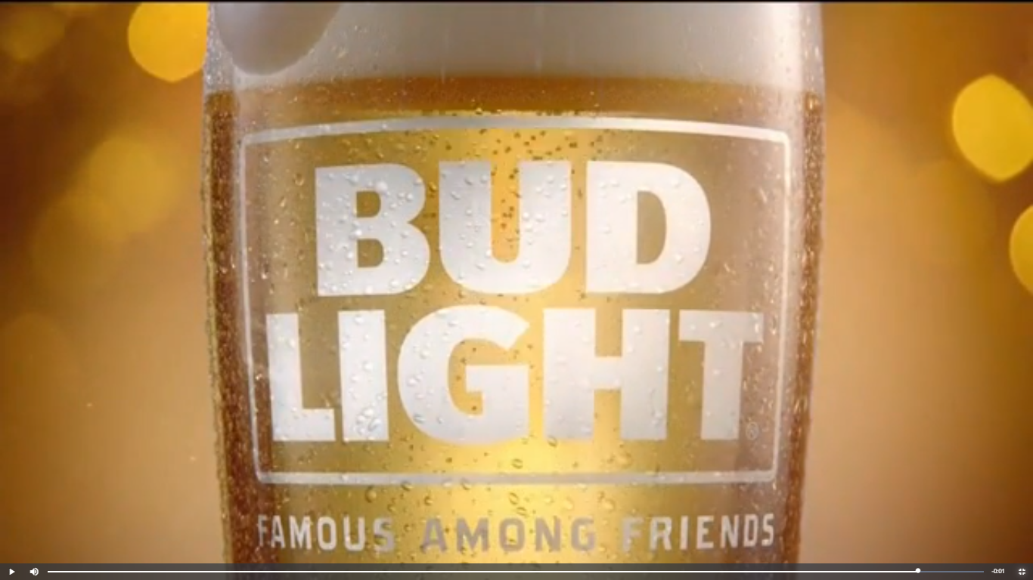
Give the Product a Starring Role
PRINCIPLES OF DESIRABILITY
When the brand impressions occur during emotional peaks (& troughs (especially if it is the source of those extremes) it will be more likely encoded, remembered & recalled In this Bud Light “Sacrifice” spot, the punchline triggers the ads highest emotional peak which ushers in an undeniably clear end frame for a full 2 seconds, sustained by accompanying VO.
Bud Light®, Sacrifice
73rd
PERCENTILE
91st
PERCENTILE
VALENCE

Slide 19
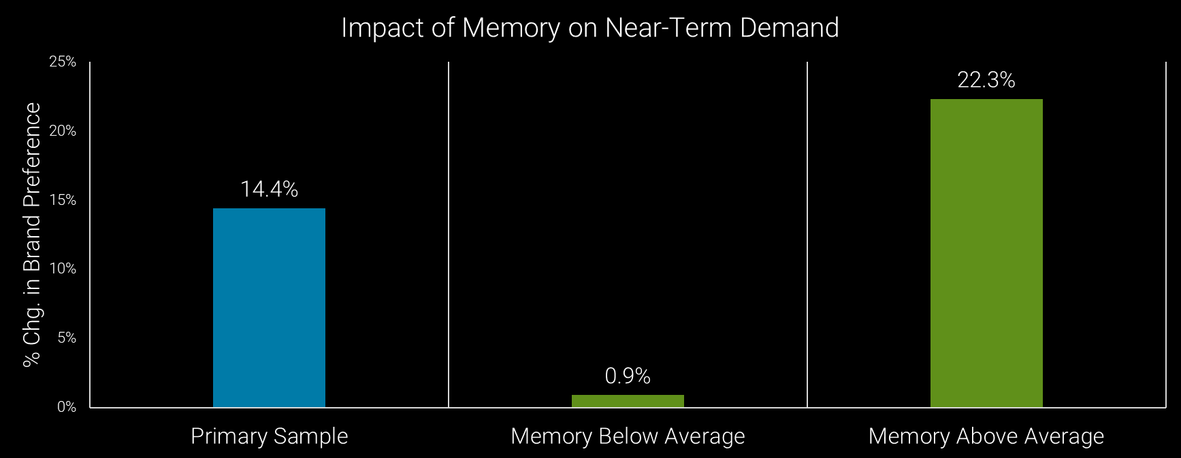
Degree of Memory for the Brand Advertised is Directly Related to Impact on Brand Preference

Slide 20


